Slide 1

Globalisation
An Introduction

Slide 2
Read the PowerPoint and complete the activities and tasks mentioned in the PowerPoint.

Slide 3

Learning Intentions
1. To explore the concept of globalisation.
2. To learn about the causes and effects of globalisation.
3. To understand how globalisation affects different people.

Slide 4
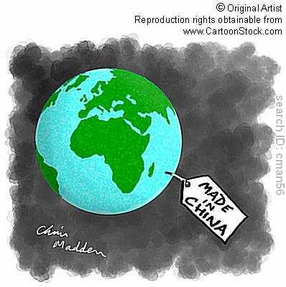
Starter

Slide 5
Watch this clip:
Making globalisation work: Better lives for all
https://www.youtube.com/watch?v=UO4r1KEDl1Q

Slide 6

What is globalisation?
The process by which…
“the world is becoming increasingly interconnected due to increased trade and cultural exchange”
“the process by which people, cultures, money, goods and information can be transferred between countries”.

Slide 7

“A small world becoming smaller”

Slide 8
Activity
CAUSES of Globalization

Slide 9

Factors which contribute to globalisation!
ICT…

Slide 10
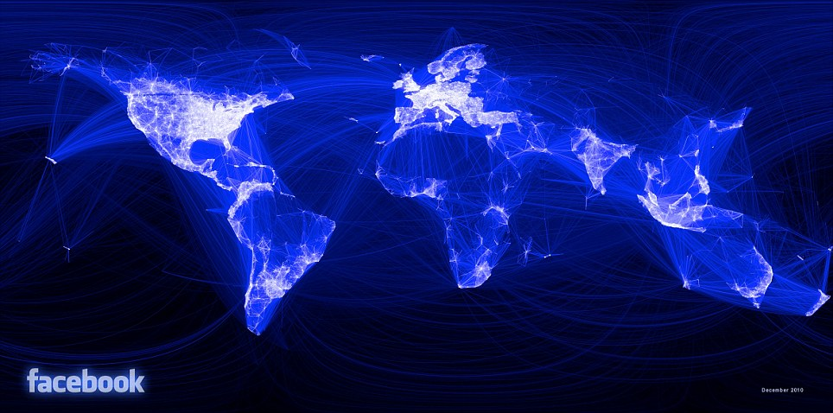

Slide 11
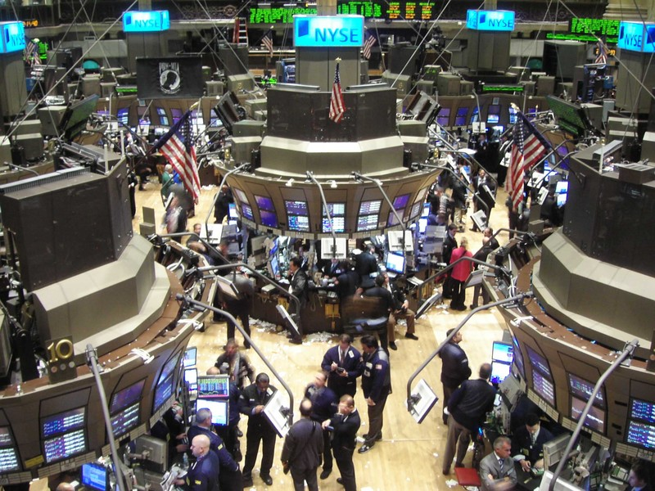
Factors which contribute to globalisation
Increased Trade…

Slide 12
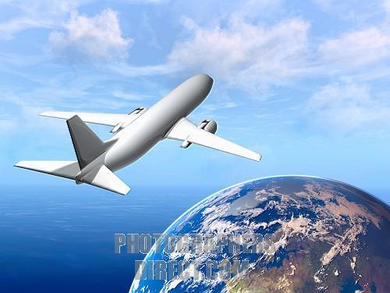
Factors which contribute to globalisation
Transportation Developments…

Slide 13


Factors which contribute to globalisation
Transnational Corporations…

Slide 14

Answer the following questions questions in the space below:
Can you identify any advantages of globalisation?
Can you identify any disadvantages of globalisation?
Who does globalisation effect?

Slide 15
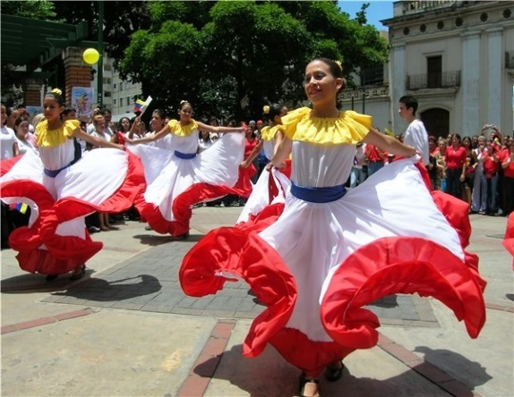
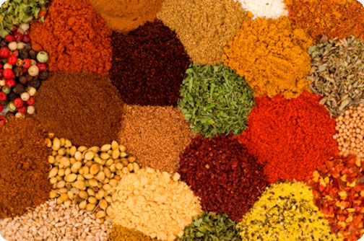
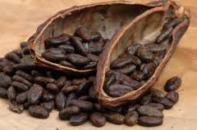
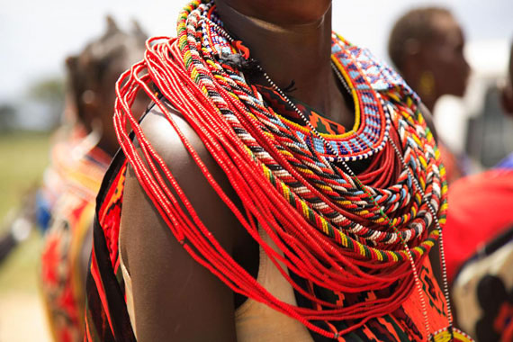



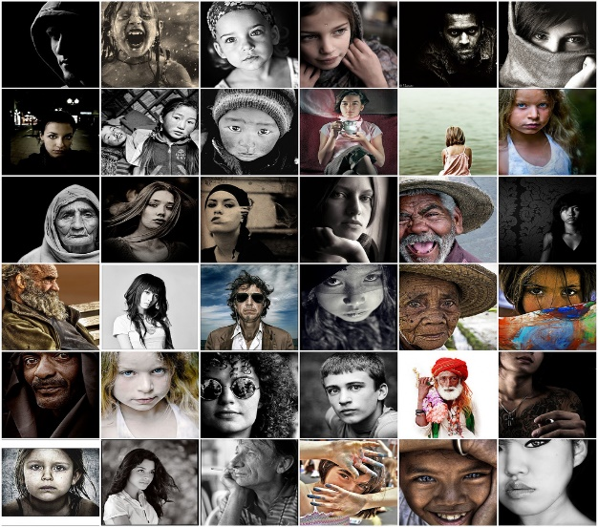


GLOBALISATION

Slide 16
Watch this clip-
Advantages and disadvantages of globalization
https://www.youtube.com/watch?v=i-eHj6bVU8w

Slide 17

Advantages
Globalisation can provide jobs for poorer and indigenous people and help them to learn new skills.
It can bring wealth to local economies when companies have to buy products and resources.
It is a way of sharing ideas and experiencing new cultures and lifestyles.
How quickly did we find out about the Indian Ocean Tsunami or the earthquake in Haiti? Globalisation increases awareness of things throughout the world.
Maybe then people can become more aware of important global issues such as global warming or deforestation.
There is more food and clean water readily available.

Slide 18
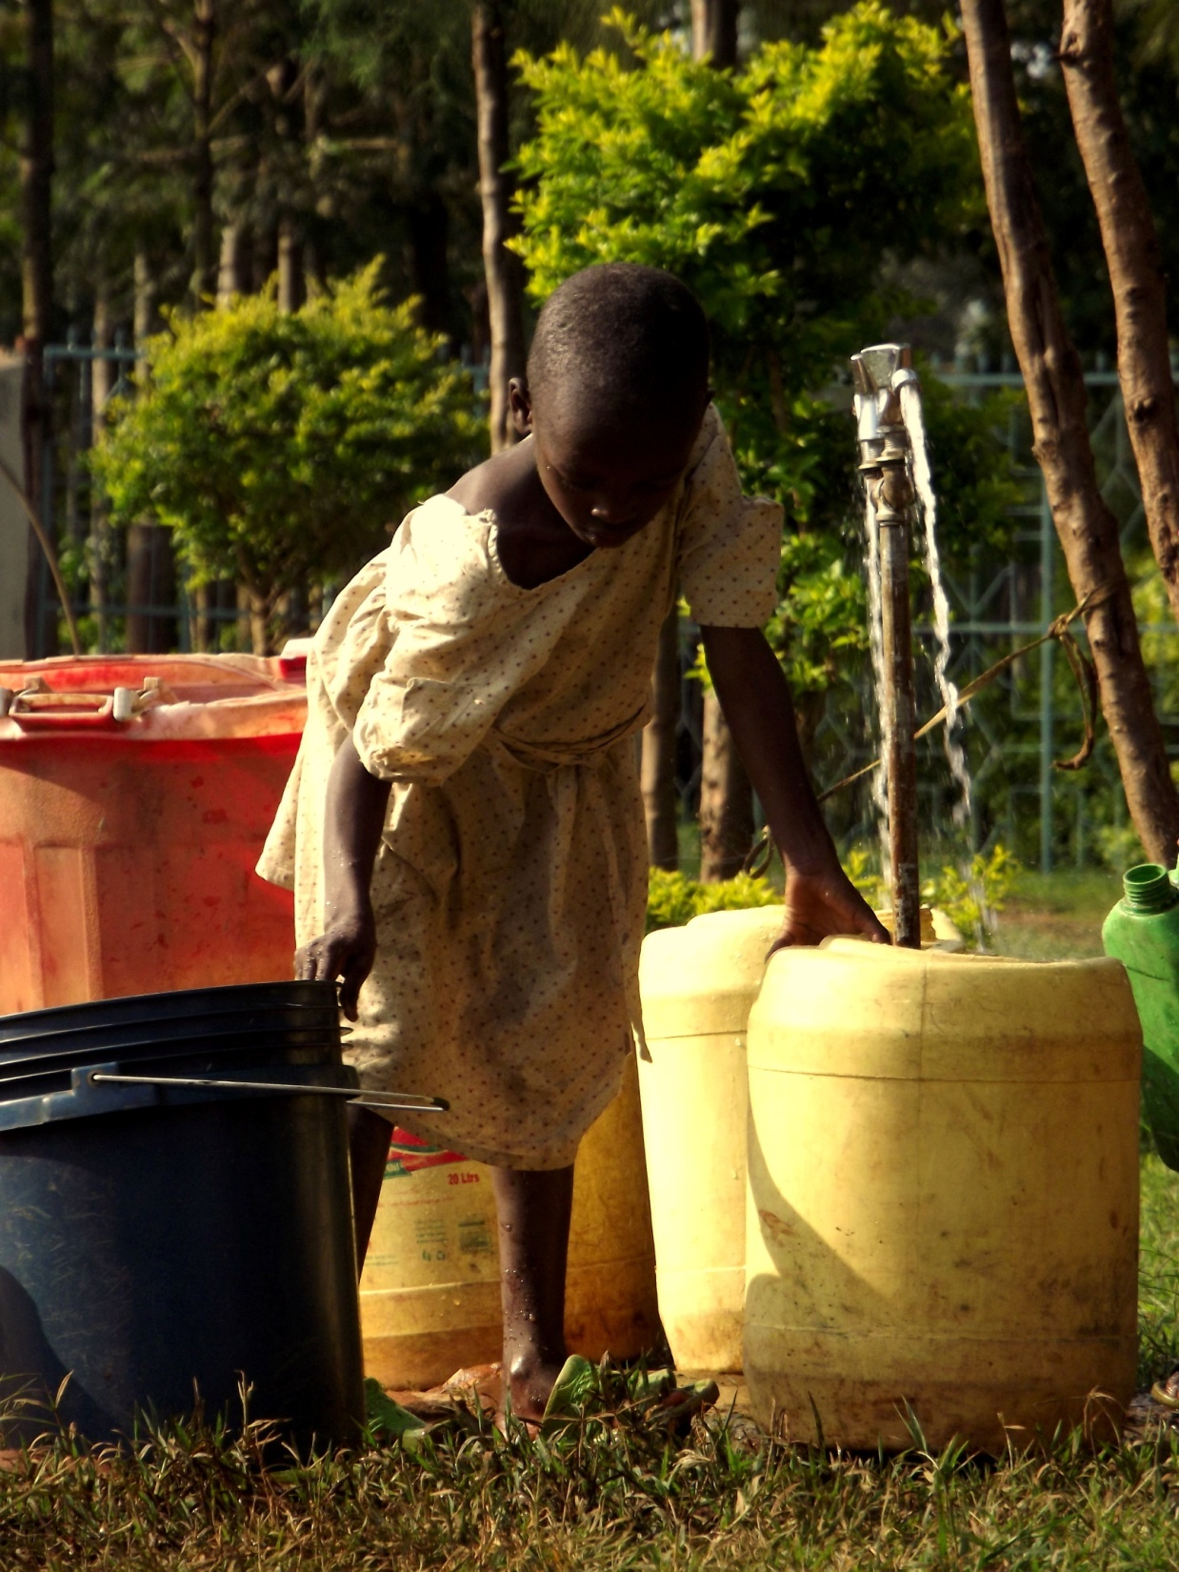
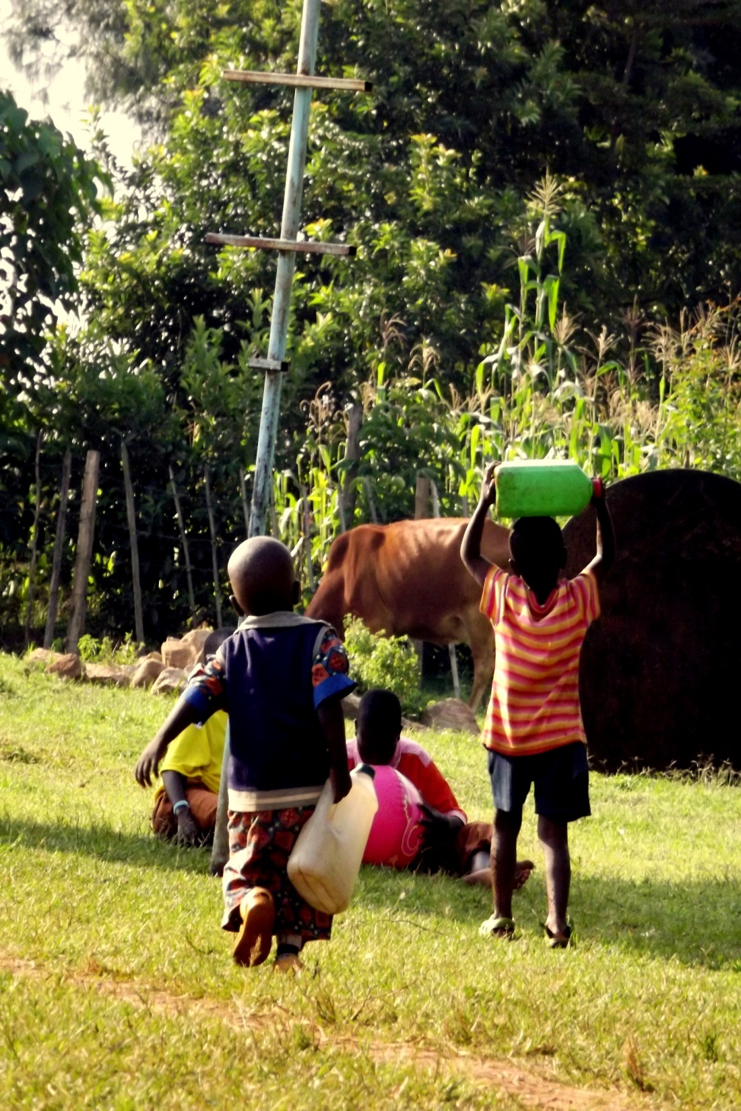

Slide 19

Disadvantages
There is no way of guaranteeing that the wealth will help the developing country.
Pollution of the environment, safety risks, low wages, poor working conditions.
There is a chance that because there are so many developing companies in foreign countries – jobs could potentially be lost in the more developed countries.
Traditions, languages and cultures could be lost.
The role of the developing country in everything is to provide when it already struggles to provide for itself.
Local companies could be driven out of business.

Slide 20

Task... Choose ONE option...
In your own words write a short speech that could be given to some of the people who are protesting against globalisation. Use the advantages we have discussed and your own ideas to try and convince them that globalisation is a good idea.
In your own words write a
protesting speech towards
businesses and companies
who promote globalisation.
Tell them why it is a bad idea.

